Slide 1
Digital Electronics (EE221)

Slide 2
Parameter | CMOS | TTL | ECL
Basic gate | NAND/NOR | NAND | OR/NOR
Fan-out | >50 | 10 | 25
Power per gate (mW) | 1 @ 1 MHz | 1 - 22 | 4 - 55
Noise immunity | Excellent | Very good | Good
t_{PD} (ns) | 1 - 200 | 1.5 – 33 | 1 - 4

Slide 4
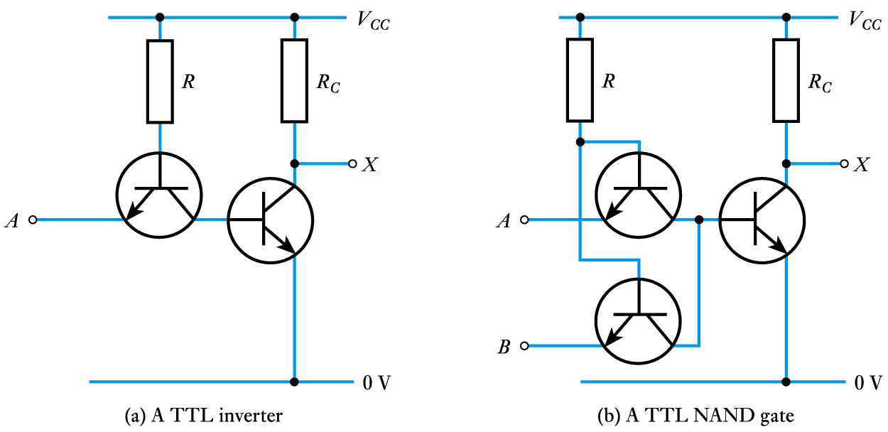

Slide 6
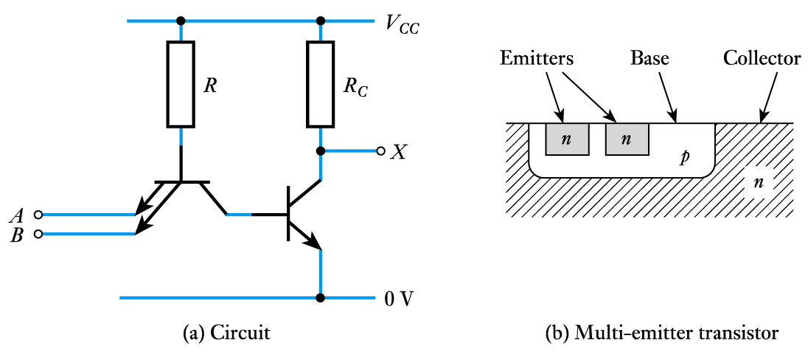

Slide 9
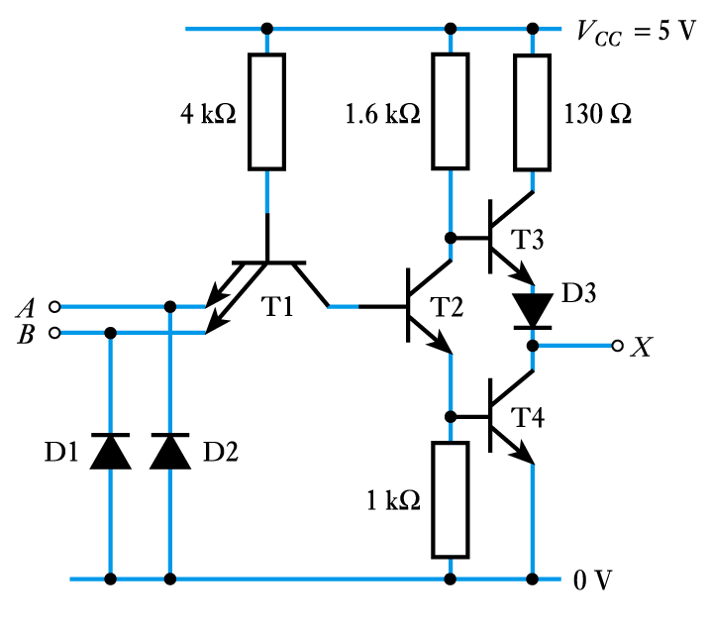

Slide 11
